Slide 1


Slide 2
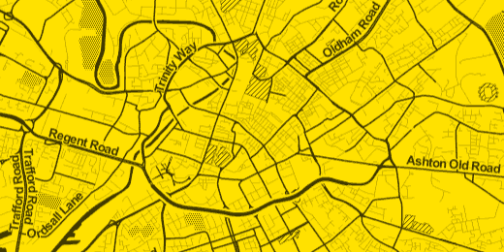

Geek Night
Tramchester & Graph Databases
Nima Montazeri
@Nimamon
Ben Earlam
@BenEarlam

Slide 3
Agenda
What is a Tech Lab?
Tramchester
Technologies
  Cloud Infrastructure
  Graph DB (Neo4J) - Demos in C# and Java
    Models
    Benefits
    Learnings / Issues

Slide 4
What is a Tech Lab?
Experiment and learn about technology
Time-boxed
  6 weeks maximum
Small team
  Core of 3 people (2 Developers, 1 BA)
    With support and expertise as needed
Notes:
----- Meeting Notes (25/09/2013 14:00) -----

Slide 5
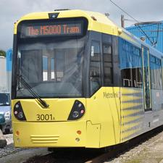
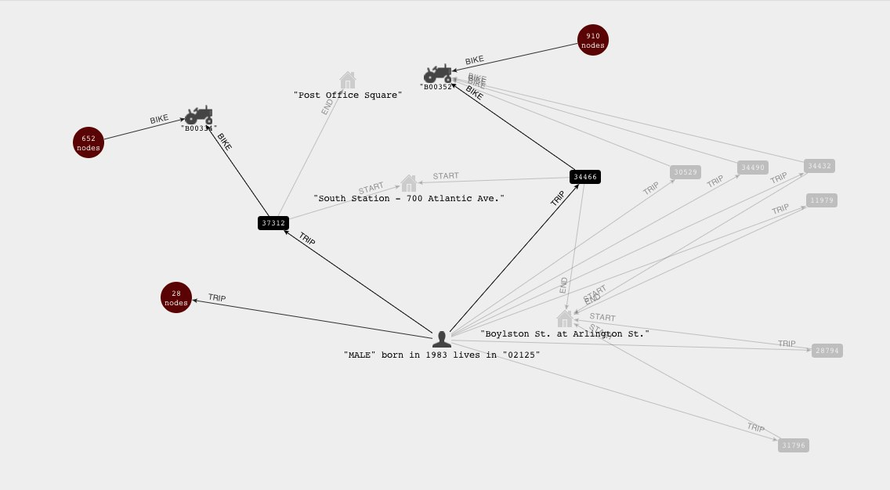

What did we look at?
Domain: Travel in and around Manchester
  Raw Data is available from http://www.datagm.org.uk/
  Idea was crowd sourced
Tech: Not Only SQL
  Experiment with Graph database as way of modeling a travel network
Tech: cloud
  Host in AWS

Slide 6
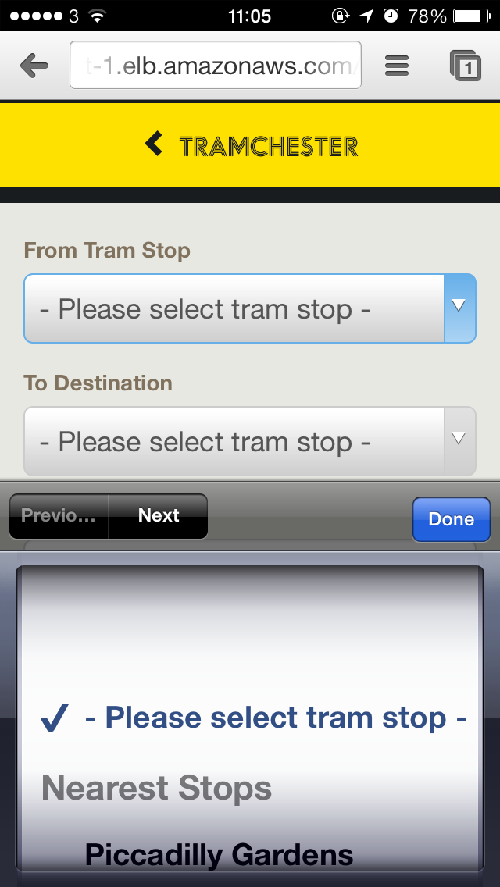
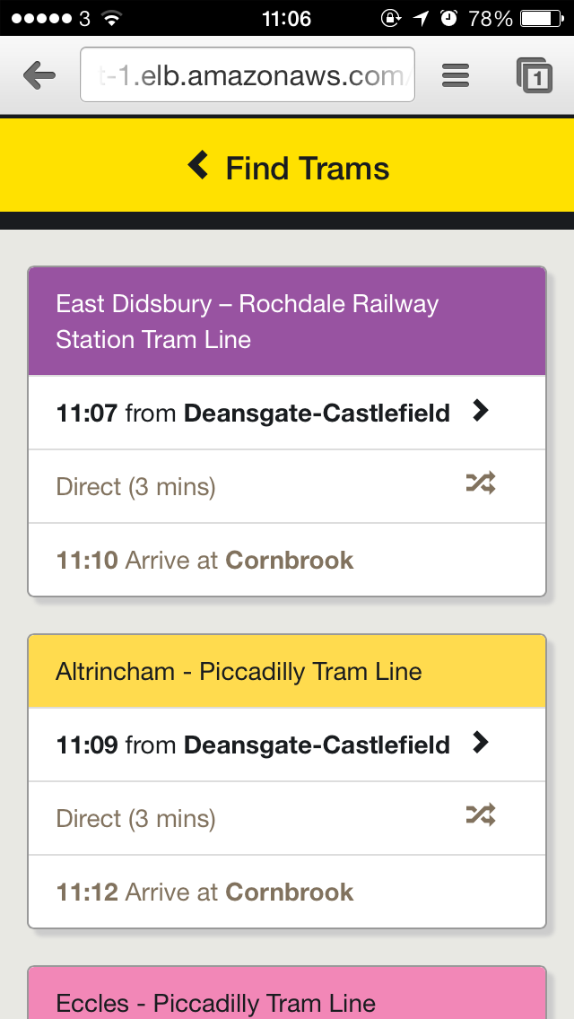
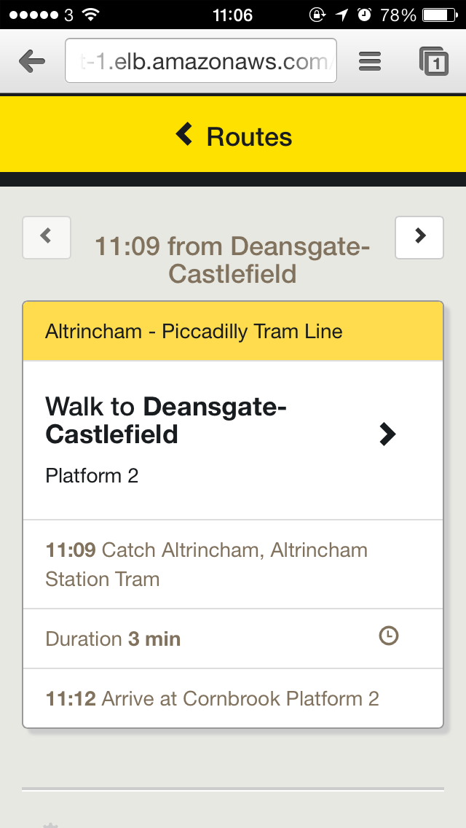
The App
  http://www.tramchester.co.uk/

Slide 7
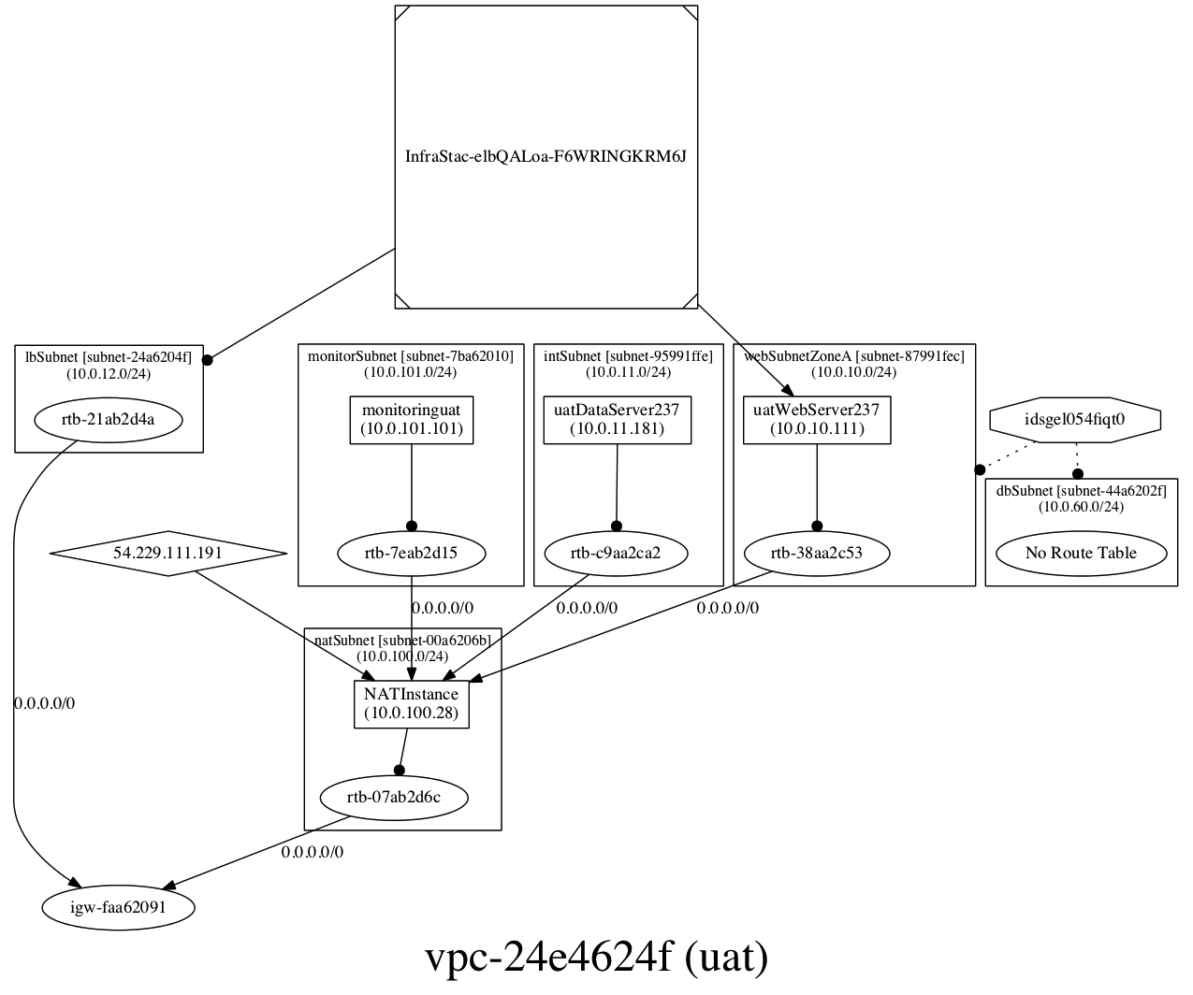
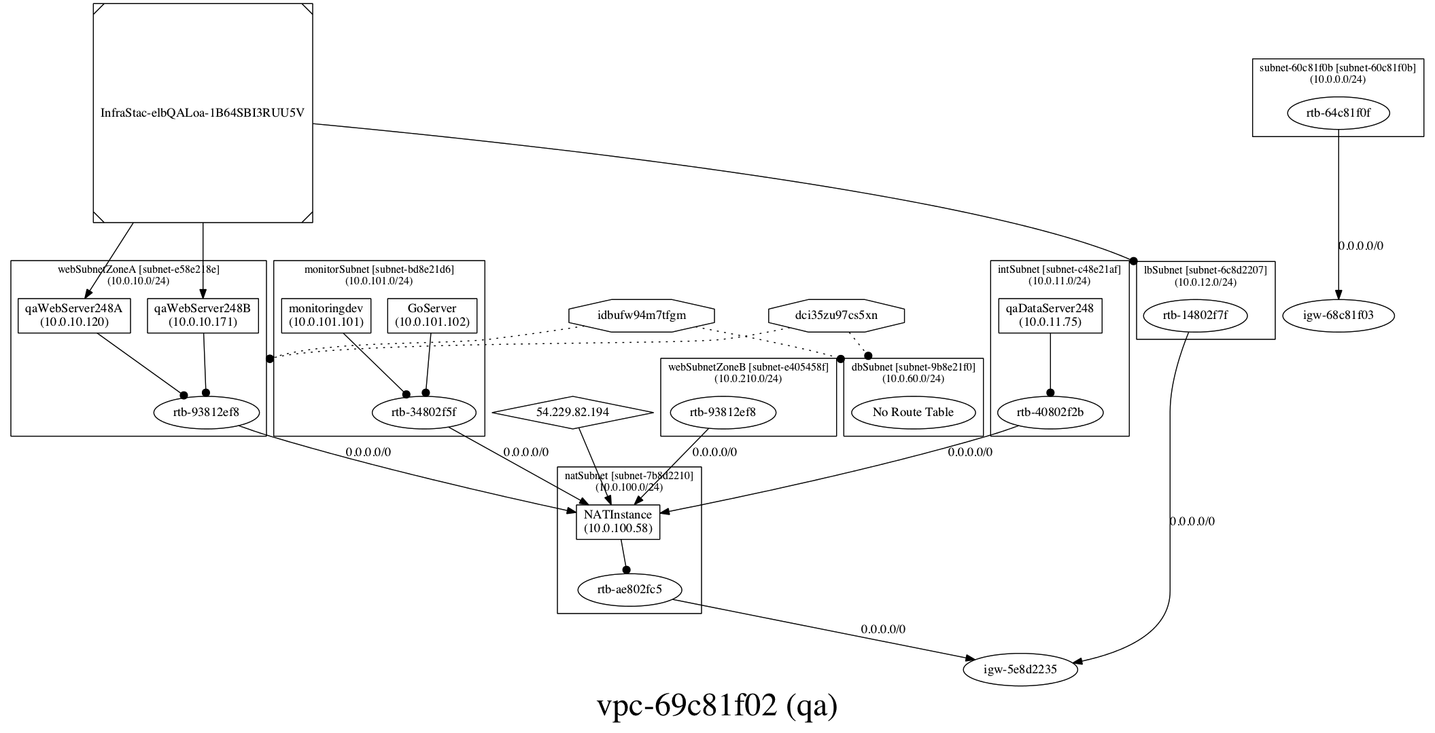
Why the cloud?
Keep things “Realistic”
  Compiling and running on a laptop doesn’t tell us enough
Very easy to automate and script AWS
Keep costs reasonable and controllable
Experiment; not sure what we would need

Slide 8
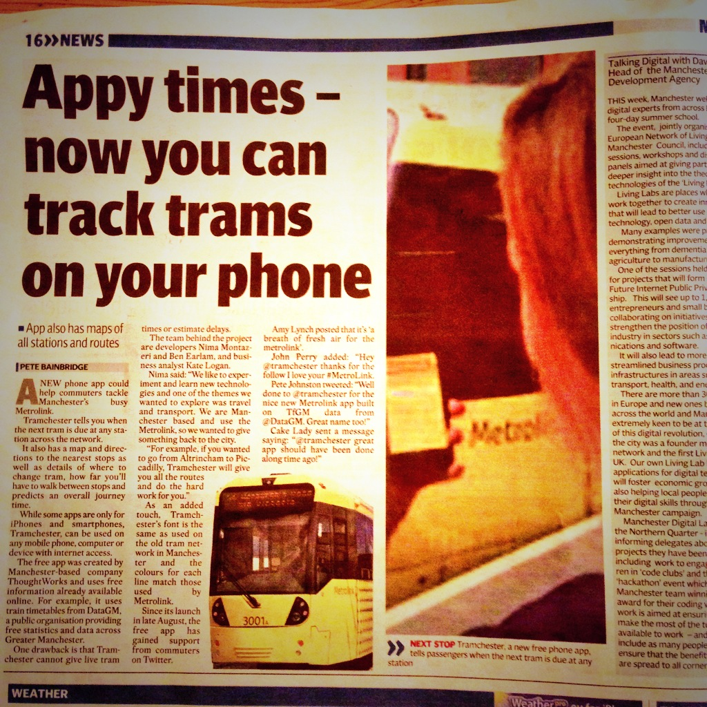
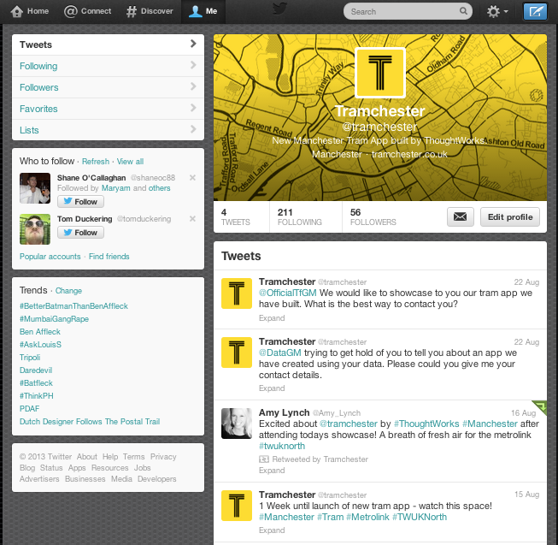


A nice problem to have…..

Slide 9
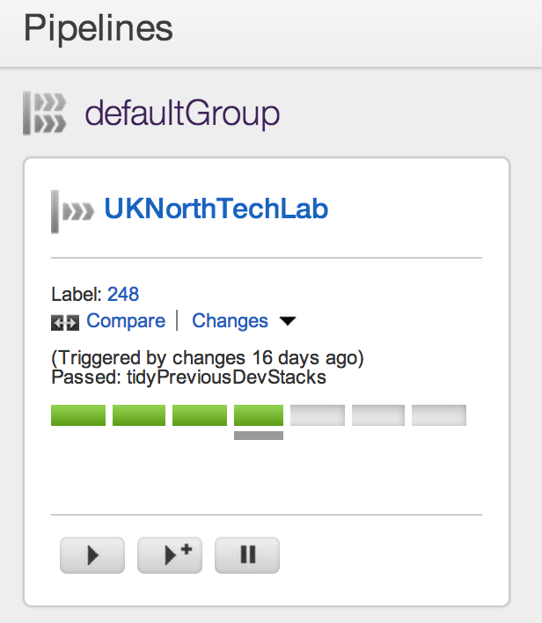
Deployment
Continuous Deployment
  We used Go
Use Phoenix Server pattern
Ant, shell scripts and Cloud Formation
cloudinit for “bootstrapping” software on to the instances

Slide 10

Phoenix Server
Axiom: It is easier to create new instances and install software on to them than it is to try and upgrade and reconfigure software on existing instances
Wanted to avoid complex chef/puppet scripts
  We avoided chef/puppet entirely ☺
“Banned” manual updates to deployed instances

Slide 11
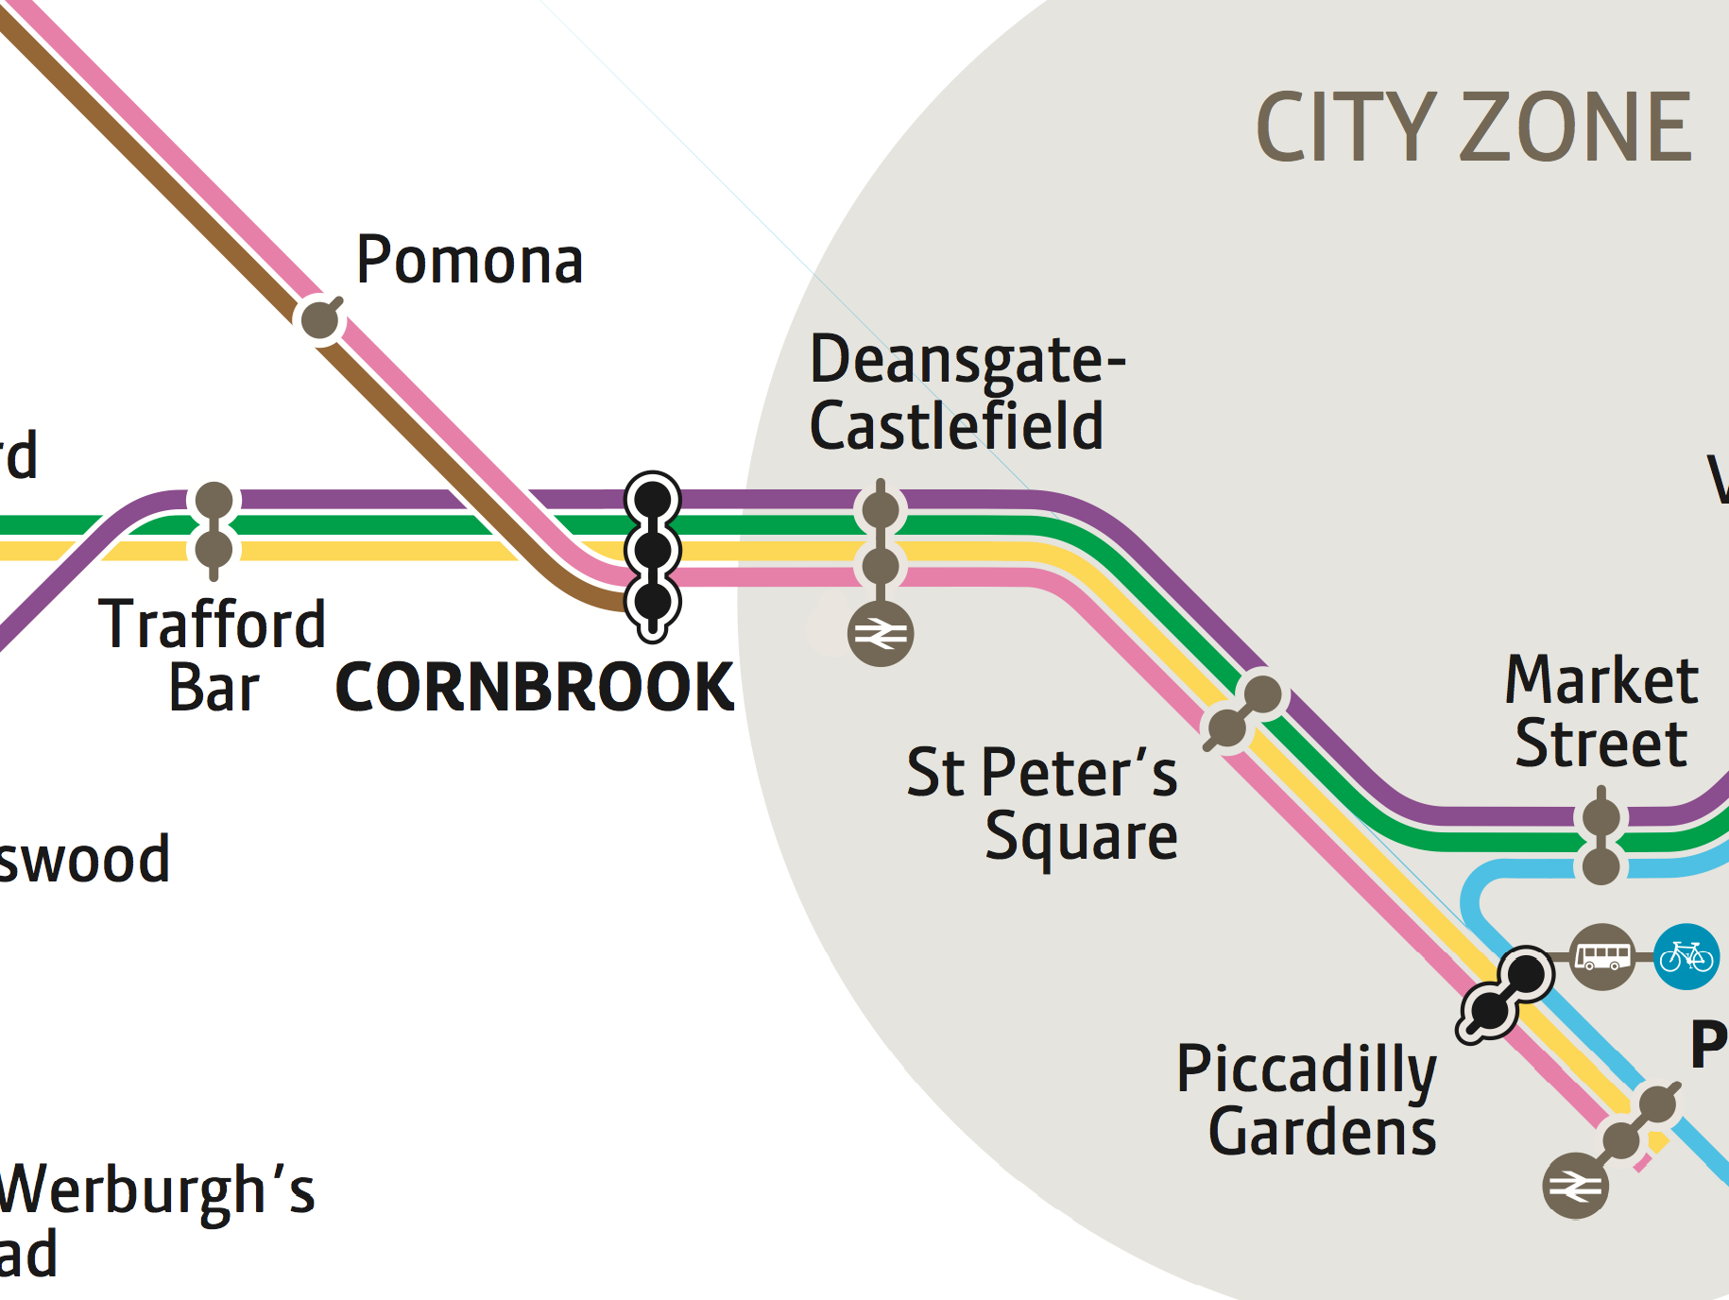
Why a graph database?
5
2
3
2
5
3
2
2
Map © Transport for Greater Manchester 2013

Slide 12
Neo4J
Neo4J is a Graph Database:
Graph
  A property Graph with nodes and relationships
  Perfect for complex highly connected data
Database
  Reliable with real ACID transactions
  Scalable: 32 Billion Nodes, 32 Billion Relationships & 64 Billion Properties
  Server with REST API, or Embeddable on JVM

Slide 13
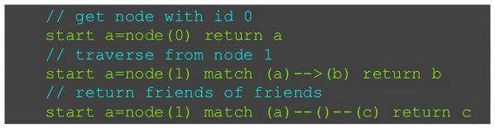
Cypher
Graph Query Language
A pattern-matching query language
Declarative grammar with clauses (Like SQL)
Aggregation, Ordering, Limits
Create, Read, Update, Delete

Slide 14
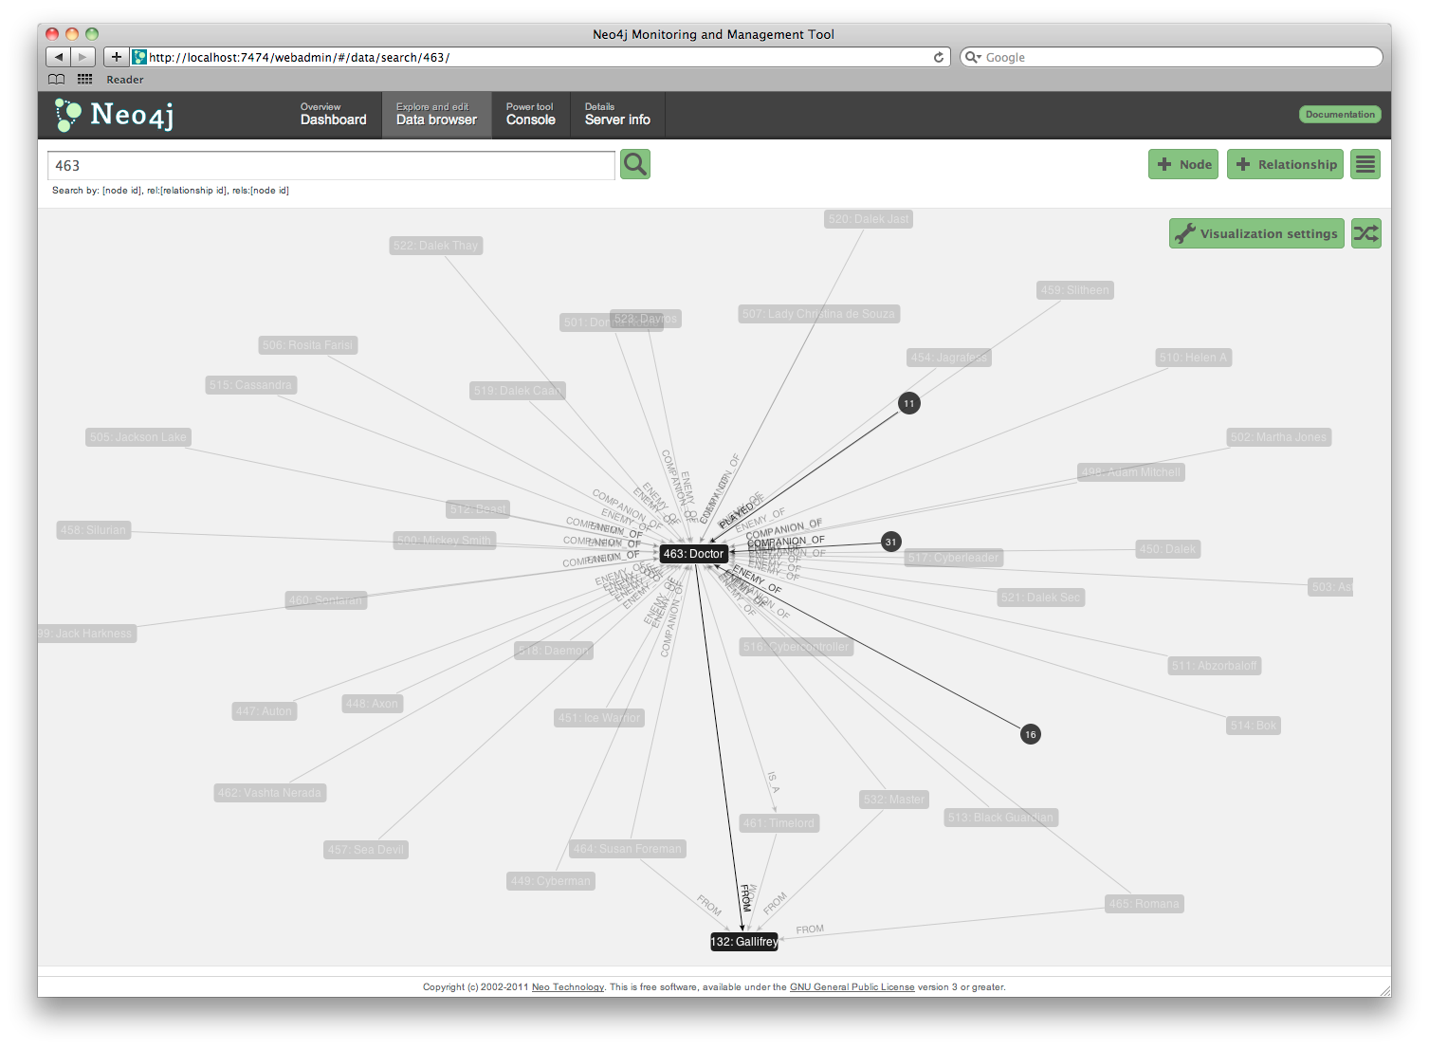
Demo 1
Neo4J Web Interface, Cypher, C# example

Slide 15
Benefits of Graph DB
Performance
  Sheer performance increase when dealing with connected data versus relational database
  Performance tends to remain relatively constant as the data grows
Notes:
Performance: Performance remains constant because queries are localized to a portion of the graph. As a result, the execution time for each query is proportional only to the size of the part of the graph traversed to satisfy that query, rather than the size of the overall graph.
Flexibility: allowing structure and schema to emerge in tandem with our growing understanding of the problem space, rather than being imposed upfront, when we know least about the real shape and intricacies of the data.

Slide 16
Performance
Get is from the Book
Depth | MYSQL (seconds) | Neo4J (seconds) | No. of Records
2 | 0.016 | 0.01 | ~2500
3 | 30.26 | 0.16 | ~110,000
4 | 1543.50 | 1.359 | ~600,000
5 | Unfinished | 2.132 | ~800,000
Example from Neo4j In Action, Jonas Partner and Aleksa Vukotic

Slide 17
Add Slide
RDBS vs Graph

Slide 18
Benefits of Graph DB
Flexibility
  Allows structure and schema to emerge in tandem with our growing understanding of the problem space
  Graphs are naturally additive, meaning that we can add new relationship types, nodes and sub graphs to existing graph

Slide 19
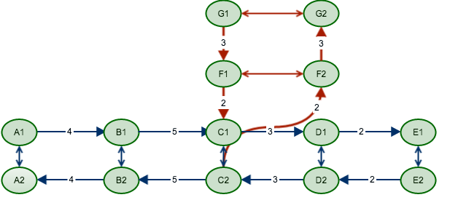
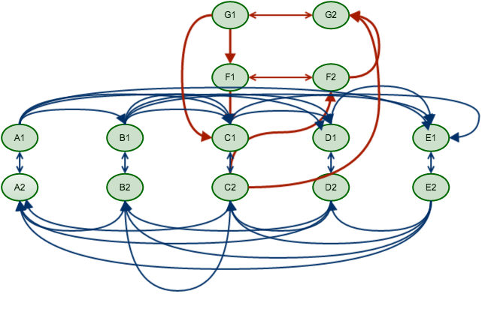
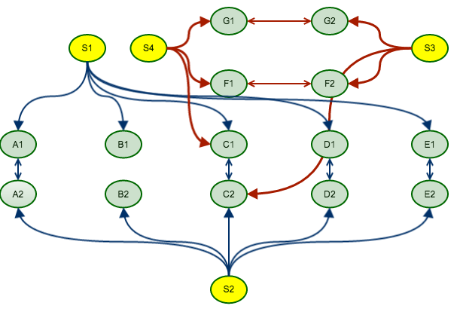
Flexibility

Slide 20

Demo 2
Java Code Sample Algorithm Factory

Slide 21
Tram Data…
Tabular Data in text file (General Transit Feed Specification)
250 Cities publish GTFS data
Stops
Stop
Times
Trips
Calendar
Stop_id
Trip_id
Service_id
Route_id
Routes

Slide 22
Graph Model – Iteration 1
G1
G2
2
2
F1
F2
A1
3
B1
4
C1
2
D1
3
E1
3
A2
3
B2
4
C2
2
D2
3
E2
Notes:
Polyglot solution -> RDBS for time tables
Neo4J for path finding
Finding correct graph model was our biggest challenge
This is our first model:
* It returned all stations between A and B
* required a lot of post processing
* didn’t handle exceptions (e.g: woodlands)
Example:
A to G => A1-B1-C1-Change Platform-C2->F2-G2

Slide 23
Graph Model – Iteration 2
G1
G2
F1
F2
S1
A1
B1
C1
D1
E1
A2
B2
C2
D2
E2
Notes:
This is our 2nd model:
* A lot of relationships
* still didn’t handle exceptions (e.g: woodlands)
* required less post processing
Example:
A to G => A1-C1-Change Platform-C2->G2

Slide 24
Graph Model – Iteration 3
S4
G1
G2
S1
S3
F1
F2
A1
B1
C1
D1
E1
A2
B2
C2
D2
E2
S2

Slide 25
Graph Model – Iteration 4
R1
A1
3
R1
B1
4
R1
C1
2
R1
D1
3
R1
E1
5
1
5
1
5
1
5
1
5
1
A1
B1
C1
E1
A1
D1
A2
B2
C2
D2
E2

Slide 26
Time Dependent Graph
T1 (08:00)
T1 (08:05)
T2 (08:12)
T2 (08:17)
T3 (08:24)
T3 (08:29)
T4 (08:36)
T4 (08:41)
T5 (08:48)
T5 (08:53)
A
T6 (09:00)
B
T6 (09:05)
C
T7 (09:12)
T7 (09:17)
T8 (09:24)
T8 (09:29)
T9 (09:36)
T9 (09:41)
T10 (09:48)
T10 (09:53)
T11 (10:00)
T11 (10:05)
T12 (10:12)
T12 (10:17)
Up to 900 Relationships
Notes:
This graph has all the time table data.
At any given period in time there are

Slide 27
Heuristics
T4 (08:36)
T4 (08:41)
T5 (08:48)
T5 (08:53)
A
T6 (09:00)
B
T6 (09:05)
C
T7 (09:12)
T7 (09:17)
T8 (09:24)
T8 (09:29)
Notes:
This graph has all the time table data.
At any given period in time there are

Slide 28
Traversal API
Declarative Java API
It enables the user to specify a set of constraints that limit the parts of the graph the traversal is allowed to visit
Can specify which relationship types to follow, and in which direction (effectively specifying relationship filters)
Can specify a user-defined path evaluator that is triggered with each node encountered
Notes:
----- Meeting Notes (25/09/2013 15:34) -----
Traversal Description
Evaluators
Traversers
Path Expanders

Slide 29
Demo 3
Time Dependent Graph / Java

Slide 30
Issues / Learnings
Thinking about graph db
Lack of code examples

Slide 31
The App
  http://www.tramchester.co.uk/

Slide 32
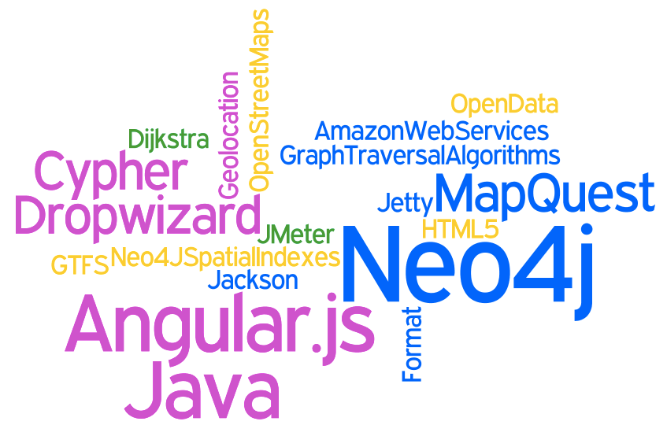
Any Questions?
Check out the app at
  http://www.tramchester.co.uk
  @tramchester

Slide 33
Firswood
Old Trafford
Cornbrook
1
2
8
4
Media City
City Centre
16

