Slide 1


Slide 2
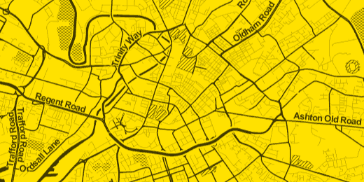

QTB Sept 2013
@thoughtworks
@tramchester
#twuknorth

Slide 3
What is a Tech Lab?
Experiment and learn about technology
Time-boxed
  6 weeks maximum
Small team
  Core of 3 people (2 Developers, 1 BA)
    With support and expertise as needed

Slide 4

Tech Lab - Desired Outcomes
Tech Learning
  Understand the pros and cons of a technology
  What is good and what is not so good
Working Software to demo
  Create something real!
Produce collateral
  Produced tangible outputs we can share
Excite Community
  Get people excited about what we are doing
Less important
More important
Actually we want them all please
Tech Learning
Working software to demo
Produce Collateral
Excite community

Slide 5
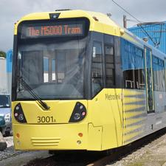
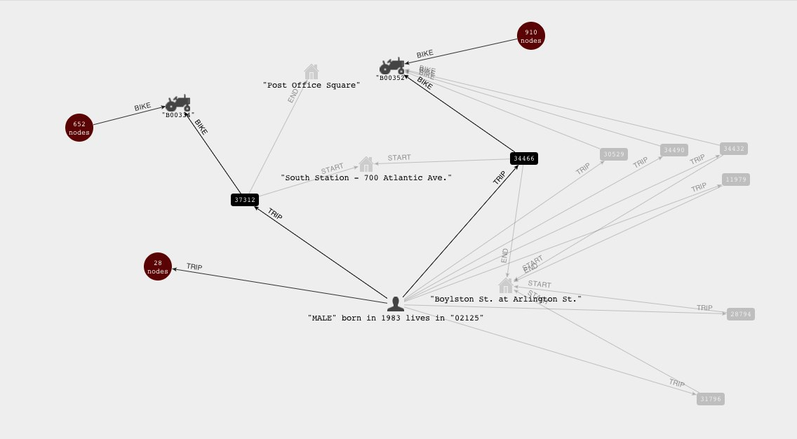

What did we look at?
Domain: Travel in and around Manchester
  Raw Data is available from http://www.datagm.org.uk/
  Metrolink was initial focus
Tech: Not Only Sql
  Experiment with Graph database as way of modeling a travel network
Tech: cloud
  Host in AWS

Slide 6
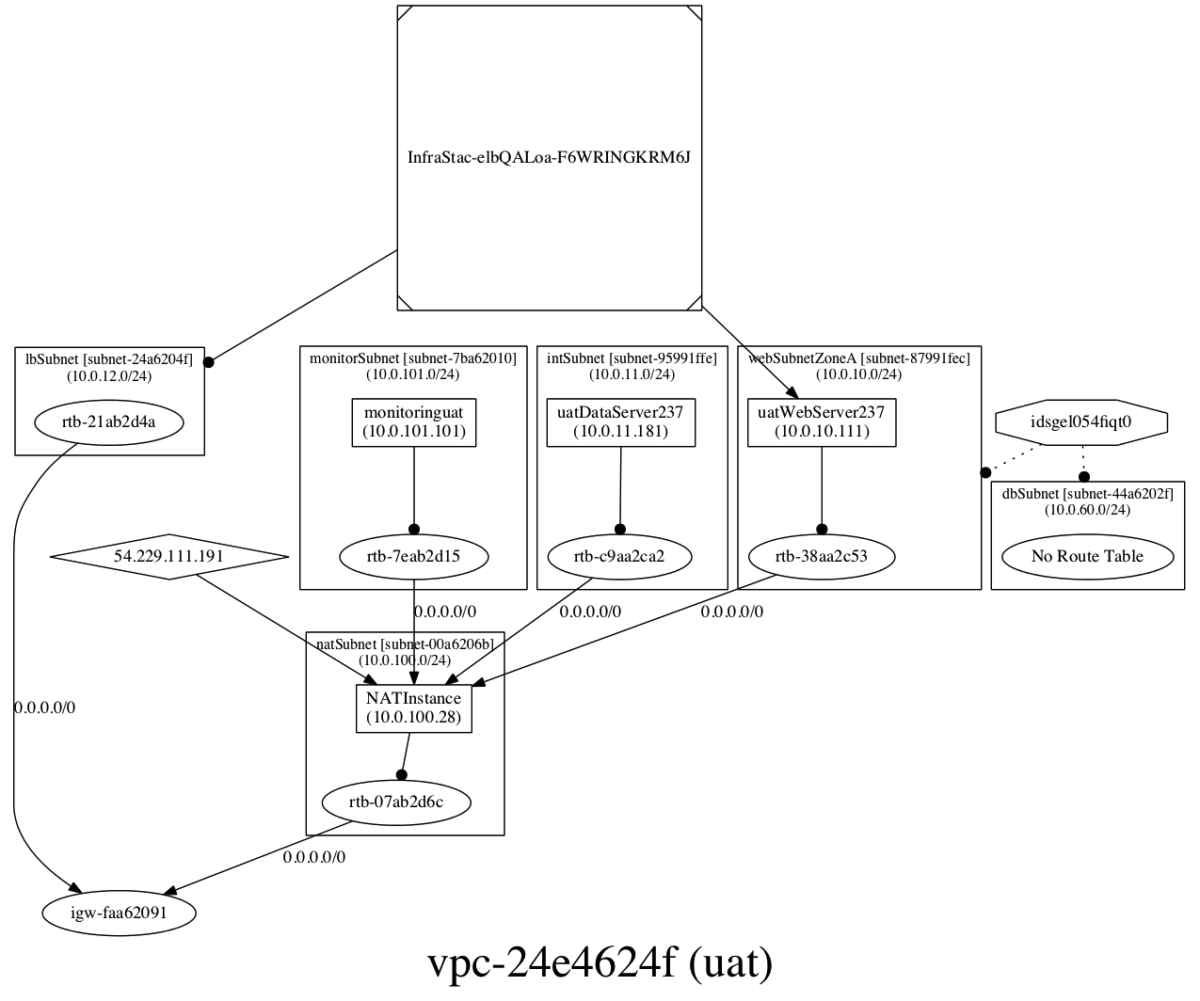
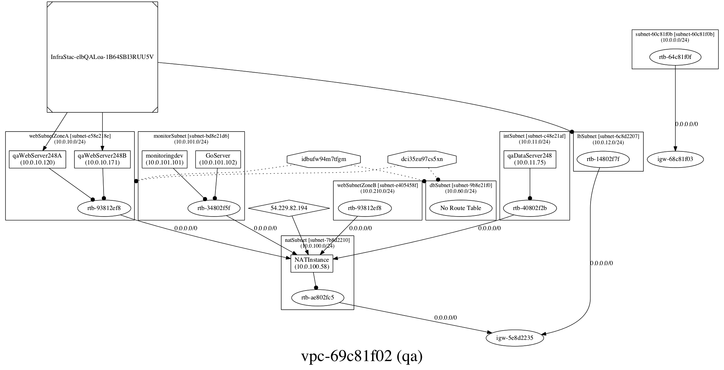
Why the cloud?
Keep things “Realistic”
  Compiling and running on a laptop doesn’t tell us enough
Experiment; not sure what we’d need
Keep costs reasonable and controllable
Very easy to automate and script AWS

Slide 7
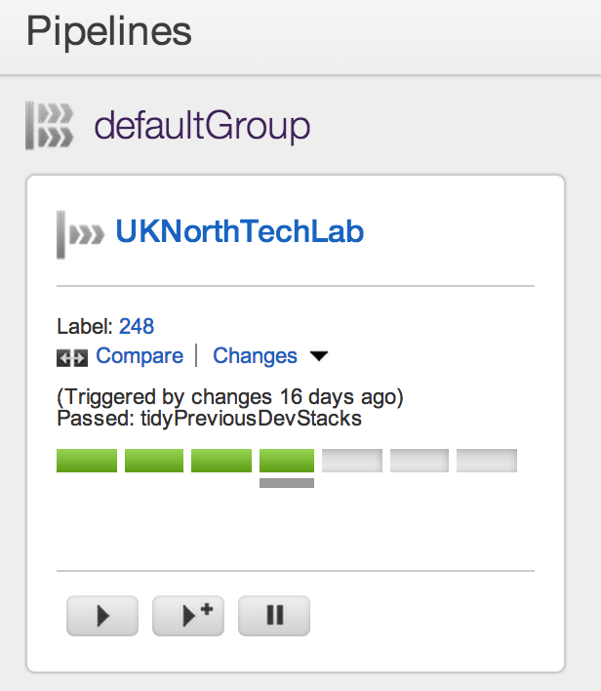
Deployment
Continuous Deployment
  We used Go
Use Phoenix Server pattern
Ant, shell scripts and Cloud Formation
cloudinit for “bootstrapping” software on to the instances

Slide 8

Phoenix Server
Axiom: It is easier to create new instances and install software on to them than it is to try and upgrade and reconfigure software on existing instances
Wanted to avoid complex chef/puppet scripts
  We avoided chef/puppet entirely ☺
“Banned” manual updates to deployed instances

Slide 9
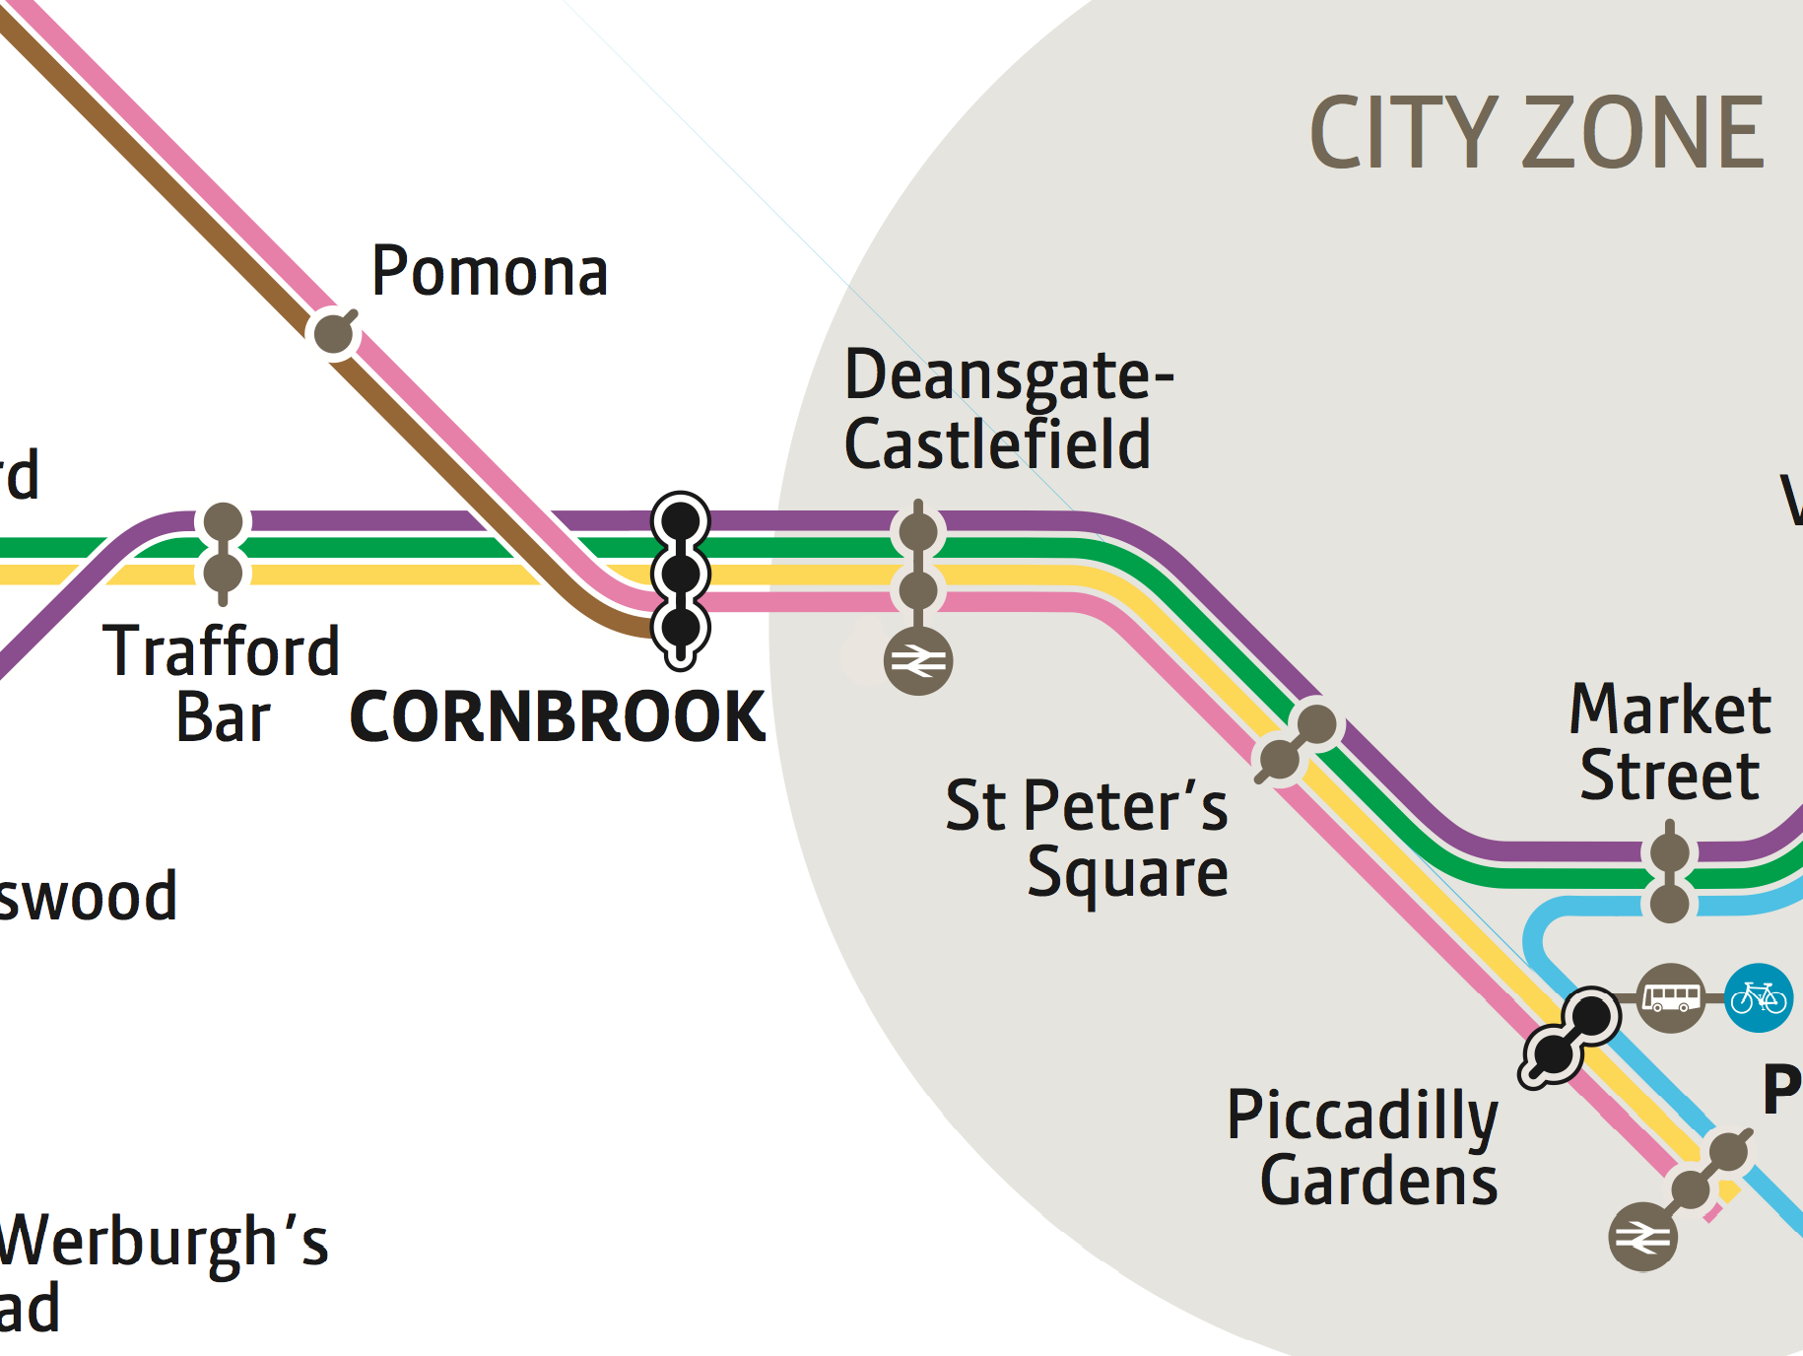
Why a graph database?
5
2
3
2
5
3
2
2
Map © Transport for Greater Manchester 2013

Slide 10
Tram Data…
Tabular Data in text file
4 Important Concepts
Stops
Routes
Services
Trips

Slide 11
Graph Model – Iteration 1
G1
G2
2
2
F1
F2
A1
3
B1
4
C1
2
D1
3
E1
3
A2
3
B2
4
C2
2
D2
3
E2
Notes:
Polyglot solution -> RDBS for time tables
Neo4J for path finding
Finding correct graph model was our biggest challenge
This is our first model:
* It returned all stations between A and B
* required a lot of post processing
* didn’t handle exceptions (e.g: woodlands)
Example:
A to G => A1-B1-C1-Change Platform-C2->F2-G2

Slide 12
Graph Model – Iteration 2
G1
G2
F1
F2
S1
A1
B1
C1
D1
E1
A2
B2
C2
D2
E2
Notes:
This is our 2nd model:
* A lot of relationships
* still didn’t handle exceptions (e.g: woodlands)
* required less post processing
Example:
A to G => A1-C1-Change Platform-C2->G2

Slide 13
Graph Model – Iteration 3
S4
G1
G2
S1
S3
F1
F2
A1
B1
C1
D1
E1
A2
B2
C2
D2
E2
S2

Slide 14
Graph Model – Iteration 4
R1
A1
3
R1
B1
4
R1
C1
2
R1
D1
3
R1
E1
5
1
5
1
5
1
5
1
5
1
A1
B1
C1
E1
A1
D1
A2
B2
C2
D2
E2

Slide 15
Time Dependent Graph
T1 (08:00)
T1 (08:05)
T2 (08:12)
T2 (08:17)
T3 (08:24)
T3 (08:29)
T4 (08:36)
T4 (08:41)
T5 (08:48)
T5 (08:53)
A
T6 (09:00)
B
T6 (09:05)
C
T7 (09:12)
T7 (09:17)
T8 (09:24)
T8 (09:29)
T9 (09:36)
T9 (09:41)
T10 (09:48)
T10 (09:53)
T11 (10:00)
T11 (10:05)
T12 (10:12)
T12 (10:17)
Up to 900 Relationships
Notes:
This graph has all the time table data.
At any given period in time there are

Slide 16
Heuristics
T4 (08:36)
T4 (08:41)
T5 (08:48)
T5 (08:53)
A
T6 (09:00)
B
T6 (09:05)
C
T7 (09:12)
T7 (09:17)
T8 (09:24)
T8 (09:29)
Notes:
This graph has all the time table data.
At any given period in time there are

Slide 17

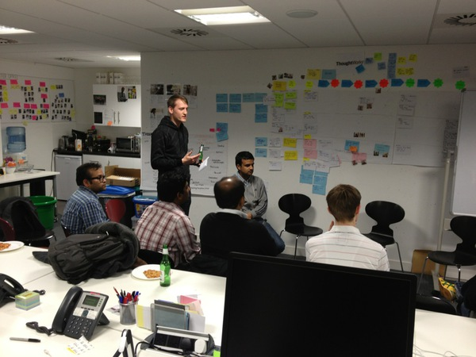
Geek Night
An introduction to
Graph Databases
Next Wednesday
September 25th

Slide 18
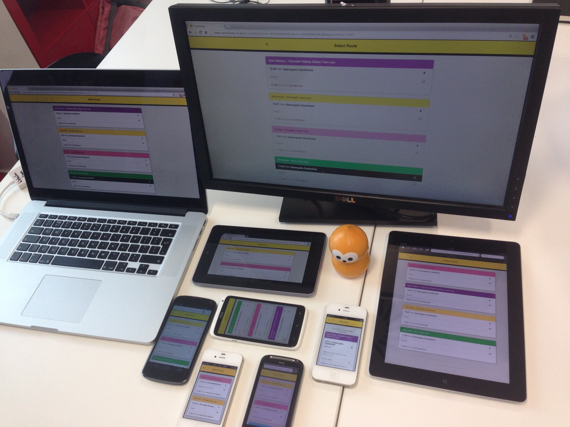
The App
  http://www.tramchester.co.uk

Slide 19
How did the team do?
Less important
More important
✔
Tech Learning
Working software to demo
Produce Collateral
Excite community
Learnt about the pros and cons of graph databases
Proved workability of this approach
Re-enforces view that need to pick the right Database model for the domain
Learnt more about using cloud formation and cloudinit

Slide 20
How did the team do?
Less important
More important
Tech Learning
✔
Working software to demo
Produce Collateral
Excite community
Built a working mobile web application
More successful than we thought!
  Local media caught on
In daily use

Slide 21
How did the team do?
Less important
More important
Tech Learning
Working software to demo
✔
Produce Collateral
Excite community
Able to produce diaries, presentations, whitepapers, videos, conferences, and labs
Including this talk ;-)
Geek Night
New York GraphConnect Conference
Notes:
Add Geek night / New York Graph Connect

Slide 22
How did the team do?
Less important
More important
Tech Learning
Working software to demo
Produce Collateral
✔
Excite community
Lots of interest inside of ThoughtWorks
  Internal talks and presentations continue
Interest outside of ThoughtWorks as well
  Next steps….?

Slide 23
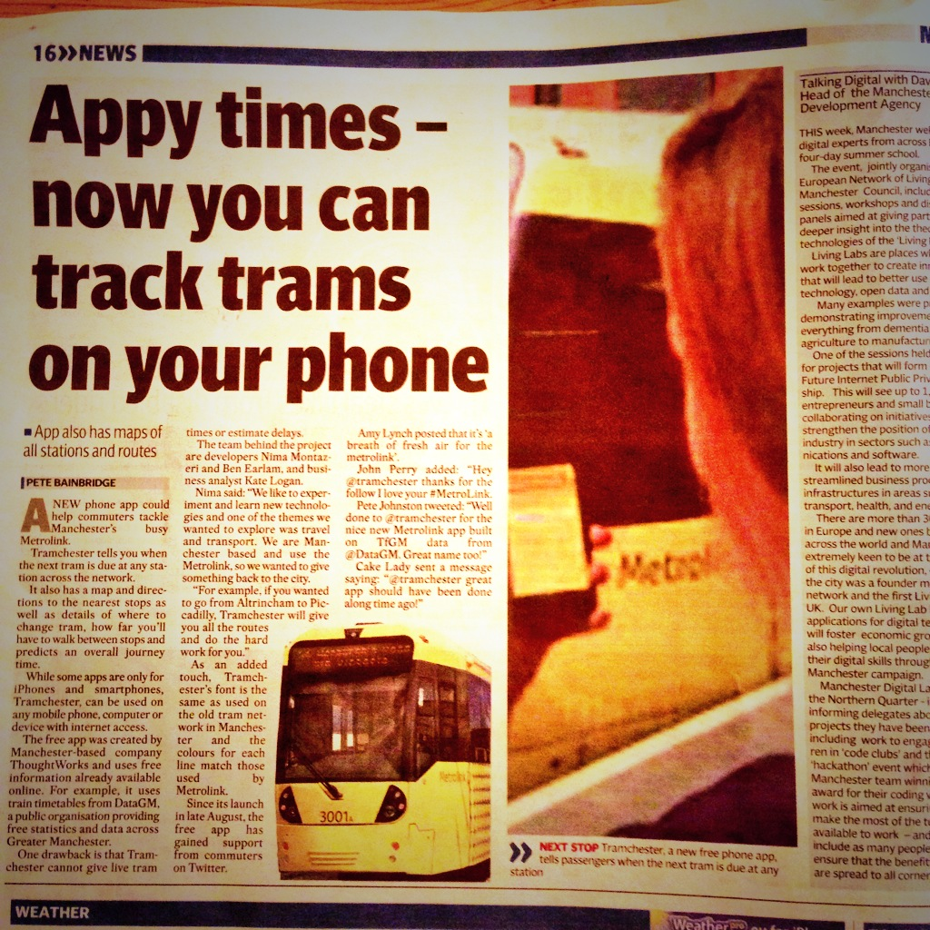
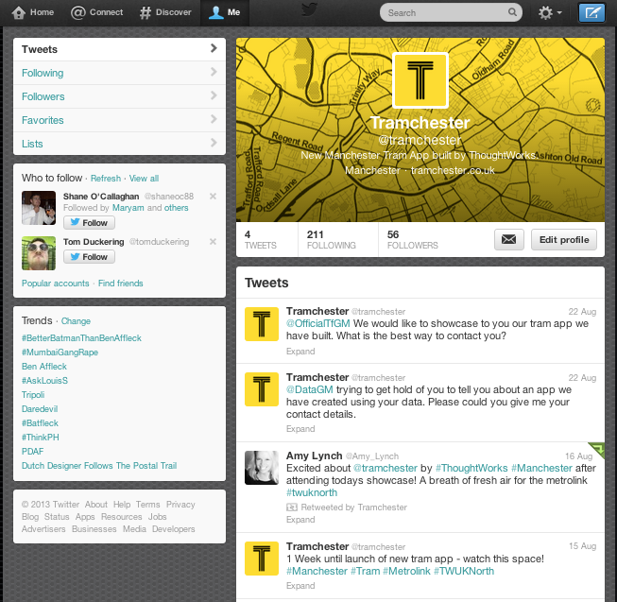

A nice problem to have…..

Slide 24
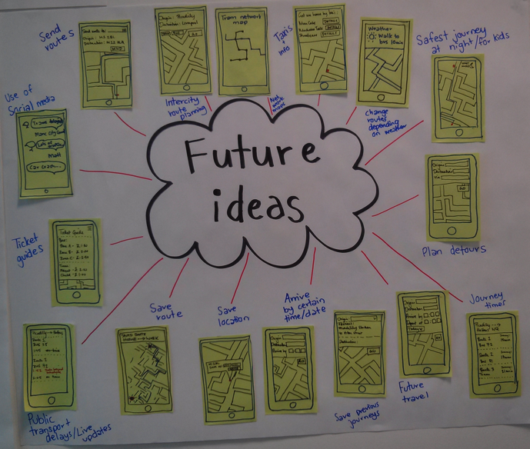
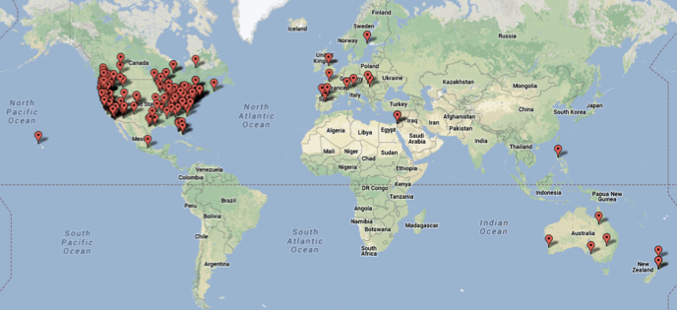
Next Steps?
Would our clients be interesting in doing TechLabs?
Team are passionate and want to continue
  Your Ideas?
  Do we Open Source?
Feature requests are still arriving…..

Slide 25
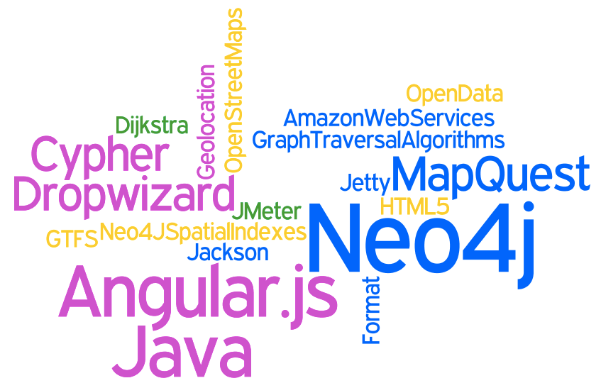
Any Questions?
Check out the app at
  http://www.tramchester.co.uk
  @tramchester

