Slide 1

Measuring Business Value
in Agile Projects
Kate Logan
@KateLoganNZ
Nima Montazeri
@Nimamon
Notes:
Hello and welcome to our talk on measuring business value in agile projects
Software development is complex……
Today we are going to talk about…..
<number>

Slide 2
WHO ARE WE?
Notes:
Kate – NZ
Nima – Iran
ThoughtWorks – Global software sonsultancy
<number>

Slide 3
Last 20 years…
1993
1999
2001
2003
2010
Scrum
Continuous Integration
Agile Manifesto
Continuous Delivery
Test Driven Development
Notes:
Focus for the last 20 years is how to build the software
Everyone is now in process of implementing this this now it does not give you a competitive advantage
Our clients ask us what us next
It is now what you are building
And building the most valuable thing
_____________________
Focuses on improving the delivery and quality of software projects
<number>

Slide 4
the right way
Notes:
<number>

Slide 5
Building the WRONG software
the right way

Slide 6
More than 50%
of functionality in software is rarely or never used.
Three studies conducted by The Standish Group (Jim Johnson, CEO The Standish Group International, XP2002 conference), the DOD (Crosstalk Journal 2002), and reported by IEEE (IEEE conference 2002).
Notes:
Nima starts then passes to Kate
<number>

Slide 7
Is a project successful if it delivered all features on
time and on budget?
Notes:
Traditionally I think the answer was yes
<number>

Slide 8
Measures of Success?
Budget
Scope
Schedule
Notes:
A common example is velocity
Burn up
<number>

Slide 9
Wrong measure of success…
these are CONSTRAINTS!
Notes:
Kate starts passes to Nima
<number>

Slide 10
That got us thinking….
What if we could measure project’s success based on the value it was delivering?
Notes:
NIMA
<number>

Slide 11
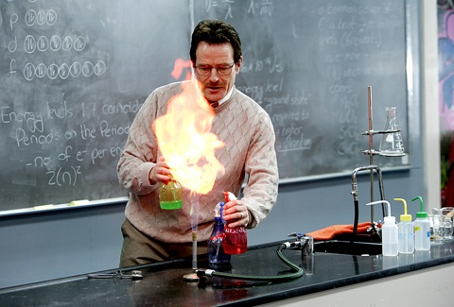
Our big experiment…
Notes:
<number>

Slide 12
Build
Learn
Measure
The Lean Startup – Eric Ries

Slide 13
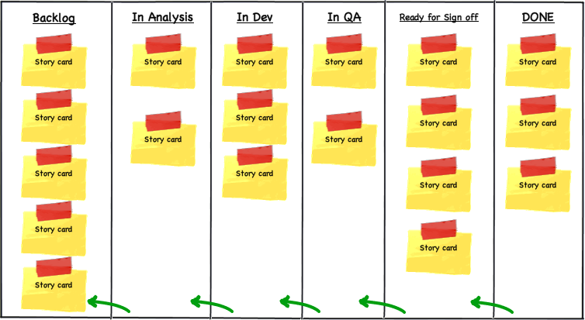

Slide 14
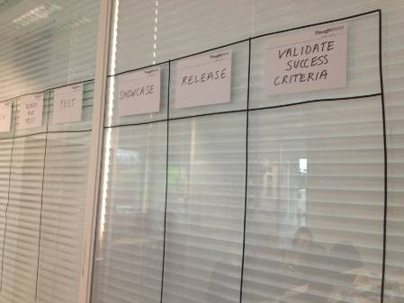
Notes:
Nima then Kate
Stakeholder prioritisation
Changing definition of done
<number>

Slide 15
Each story became an experiment to see if it delivered value
Notes:
<number>

Slide 16

Hypothesis Driven Development
Notes:
<number>

Slide 17
If _____[I do this] _____,
then _____[this]_____ will happen
Notes:
<number>

Slide 18
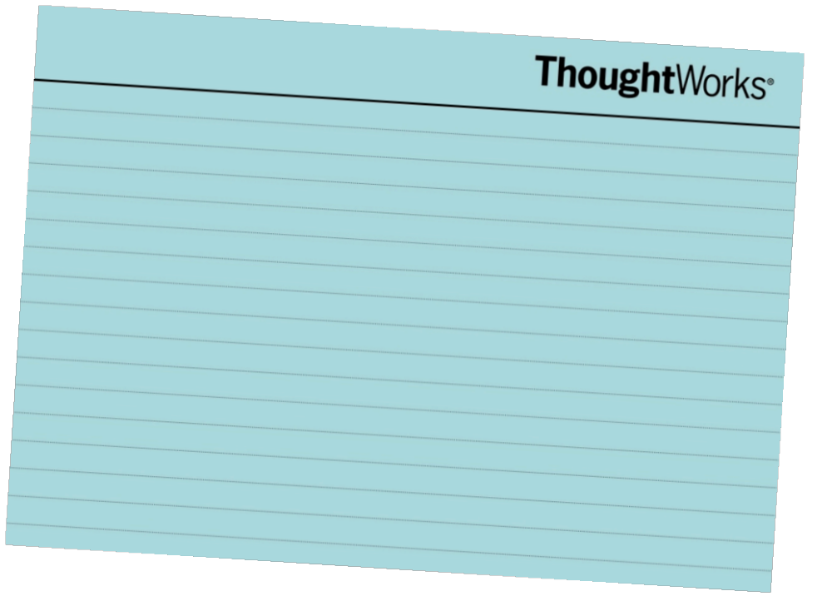
As a <user>
I want <some goal>
So that <some reason/value>
All numbers are for illustrative purposes only

Slide 19
We believe that <this capability>
Will result in <this outcome>
We will know we have succeeded
When <we see this measurable signal>
All numbers are for illustrative purposes only

Slide 20
As a customer
I want to be able to see the filter bar
So that I can adjust the results to find the best insurance
All numbers are for illustrative purposes only

Slide 21
We believe that moving the filter bar
Will result in increased customer engagement
We will know we have succeeded when usage of the filter increases by 5%
All numbers are for illustrative purposes only

Slide 22
Using the measurable signal we were able to quantify how much value this story was worth to the business in dollar terms

Slide 23
Increased communication between business and IT

Slide 24
We believe that allowing customers to change their car on the results filter
Will result in increased customer engagement with the filter bar
We will know we have succeeded when 1% of customers click to change their car
All numbers are for illustrative purposes only

Slide 25
We believe that allowing customers to change their car on the results filter
Will result in increased customer engagement with the filter bar which will increase overall conversion
We will know we have succeeded when over 1% use the change car functionality and overall conversion has increased by 0.5%
All numbers are for illustrative purposes only

Slide 26
We could validate the value of this before we had spent lots of time building out the functionality

Slide 27

Fast Feedback Cycle

Slide 28
Measuring the business outcomes developed a
Value oriented culture
Notes:
KATE STARTS!!!!!!!!!
Result of continuous measurement the development team focus is shifted to delivering business oriented outcomes
<number>

Slide 29
The goal is not features
The goal is a continuous stream of value
Notes:
<number>

Slide 30

Project Level
Notes:
Using a value framework we can calculate value on feature level, project level and Portfolio(Program) level and company level
Value Framework
What are drivers of value in your organization.
<number>

Slide 31

$$$
Measuring
Value is hard!

Slide 32
Having Fuzzy numbers about things that matter is better than having precise numbers for things that don’t matter…
Notes:
At this point people are going to challenge us saying that measuring value is hard…
Example:
We have good measures around cost because it is easy, we have poor measure around value because it is hard.
A fuzzy number is good enough for prioritization
<number>

Slide 33
Continuous Measurement
Each story should have an expected outcome that can be measured and validated
Validating outcomes will generate a fast feedback cycle and influence future development
It is important to have a value oriented culture and not be focused on constraints

Slide 34
Thank You!
Questions?
Kate Logan
@KateLoganNZ
Nima Montazeri
@Nimamon
Notes:
<number>

